Slide 1
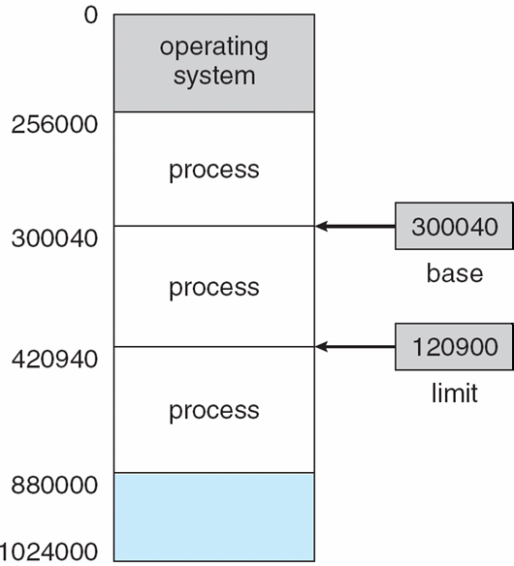
Base and Limit Registers
A pair of base and limit registers define the logical address space
CPU must check every memory access generated in user mode to be sure it is between base and limit for that user.
300040 + 120900 ➔
Notes:
We first need to make sure that each process has a separate memory space. Separate per-process memory space protects the processes from each other To separate memory spaces, we need the ability to determine the range of legal addresses that the process may access and to ensure that the process can access only these legal addresses.
We can provide this protection by using two registers, usually a base and a limit, as illustrated in Figure
The base register holds the smallest legal physical memory address;
The limit register specifies the size of the range.

Slide 2
Hardware Address Protection with Base and Limit Registers
Address must be between the base and limit.
Notes:
Protection of memory space is accomplished by having the CPU hardware compare every address generated in user mode with the registers.
Any attempt by a program executing in user mode to access operating-system memory or other users’ memory results in a trap to the operating system,
This scheme prevents a user program from modifying the code or data structures of either the operating system or other users

Slide 3
Address Binding
Programs on disk, ready to be brought into memory to execute form an input queue
Without support, must be loaded into address 0000.
Inconvenient to have first user process physical address always at 0000.
How can it not be?
Further, addresses represented in different ways at different stages of a program’s life
Source code addresses usually symbolic addresses.
Compiled code addresses bind to relocatable addresses.
i.e. “14 bytes from beginning of this module”
Linker or loader will bind relocatable addresses to absolute addresses.
i.e. 74014
Each binding maps one address space to another.
Notes:
A program resides on a disk as a binary executable file.
To be executed, the program must be brought into memory and placed within a process.
The process may be moved between disk and memory during its execution.
The processes on the disk that are waiting to be brought into memory for execution form the input queue.
Addresses in the source program are generally symbolic (such as the variable count)
A compiler typically binds these symbolic addresses to relocatable addresses (such as “14 bytes from the beginning of this module”)
The linkage editor or loader in turn binds the relocatable addresses to absolute addresses (such as 74014).

Slide 4
Binding of Instructions and Data to Memory
Address binding of instructions and data to memory addresses can happen at three different stages:
Compile time: If memory location known a priori, absolute code can be generated; must recompile code if starting location changes.
Load time: Must generate relocatable code if memory location is not known at compile time.
Execution time: Binding delayed until run time if the process can be moved during its execution from one memory segment to another.
Need hardware support for address maps (e.g., base and limit registers)
Notes:
Classically, the binding of instructions and data to memory addresses can be done at any step along the way:

Slide 5
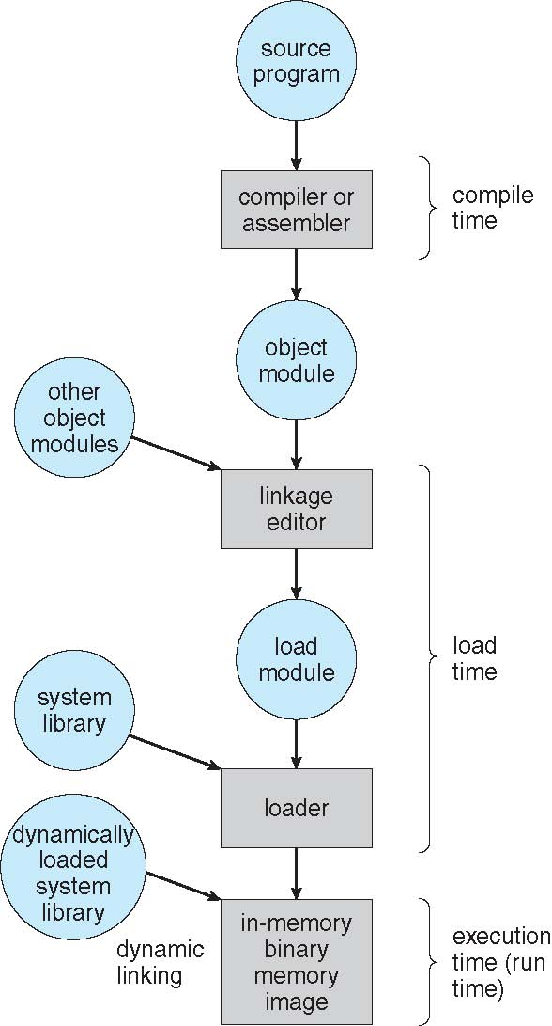
Multistep Processing of a User Program
Notes:
In most cases, a user program goes through several steps—some of which may be optional—before being executed

Slide 6
Logical vs. Physical Address Space
The concept of a logical address space that is bound to a separate physical address space is central to proper memory management
Logical address ➔ Generated by the CPU; also referred to as virtual address.
Physical address ➔ address seen by the memory unit.
Logical and physical addresses are the same in compile-time and load-time address-binding schemes; logical (virtual) and physical addresses differ in execution-time address-binding scheme.
Logical address space is the set of all logical addresses generated by a program.
Physical address space is the set of all physical addresses generated by a program.
The run-time mapping from virtual to physical addresses is done by a hardware device called the memory management unit (MMU) .
Notes:
The run-time mapping from virtual to physical addresses is done by a hardware device called the memory-management unit (MMU)

Slide 7
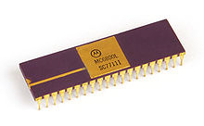
Memory-Management Unit (MMU)
Hardware device that at run time maps virtual to physical address.
Many methods possible, covered in the rest of this chapter.
To start, consider simple scheme where the value in the relocation register is added to every address generated by a user process at the time it is sent to memory
Base register now called relocation register
MS-DOS on Intel 80x86 used 4 relocation registers
The user program deals with logical addresses; it never sees the real physical addresses
Execution-time binding occurs when reference is made to location in memory
Logical address bound to physical addresses

Slide 8
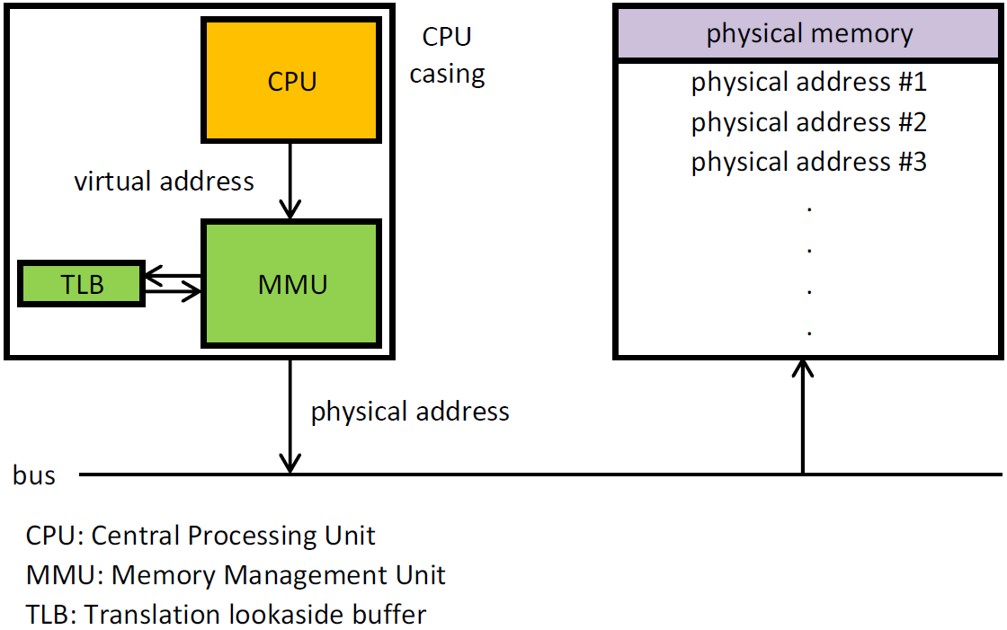

Slide 9
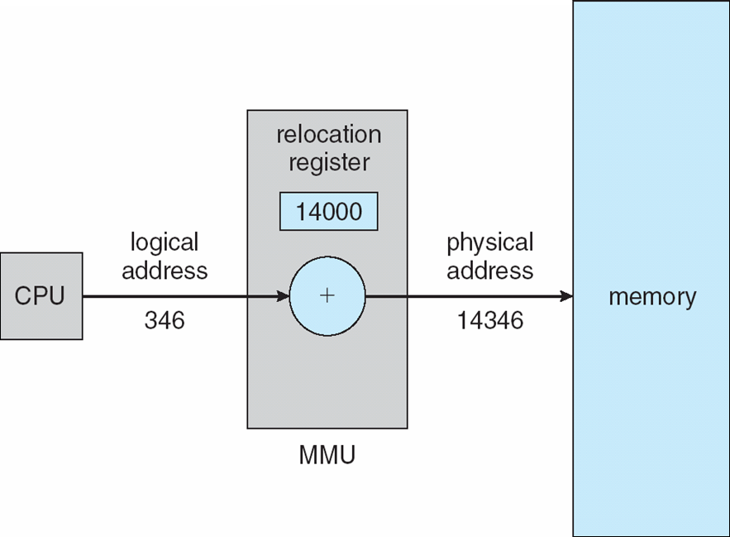
Dynamic relocation using a relocation register
Routine is not loaded until it is called.
Better memory-space utilization; unused routine is never loaded.
All routines kept on disk in relocatable load format.
Useful when large amounts of code are needed to handle infrequently occurring cases.
No special support from the operating system is required;
Implemented through program design
OS can help by providing libraries to implement dynamic loading.
The memory-mapping hardware converts logical addresses into physical addresses

Slide 10
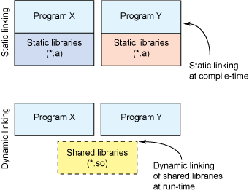
Dynamic Linking
Static linking ➔ system libraries and program code combined by the loader into the binary program image.
Dynamic linking ➔ linking postponed until execution time.
Small piece of code, stub, used to locate the appropriate memory-resident library routine
Stub replaces itself with the address of the routine, and executes the routine
Operating system checks if routine is in processes’ memory address
If not in address space, add to address space
Dynamic linking is particularly useful for libraries
System also known as shared libraries
Consider applicability to patching system libraries
Versioning may be needed
Notes:
With dynamic linking, a stub is included in the image for each library routine reference.

Slide 11
Swapping
A process must be in memory to be executed.
A process can be swapped temporarily out of memory to a backing store, and then brought back into memory for continued execution.
Total physical memory space of processes can exceed physical memory
Backing store ➔ fast disk large enough to accommodate copies of all memory images for all users; must provide direct access to these memory images
Roll out, roll in ➔ swapping variant used for priority-based scheduling algorithms;
lower-priority process is swapped out;
higher-priority process can be loaded and executed;
Major part of swap time is transfer time; total transfer time is directly proportional to the amount of memory swapped
System maintains a ready queue of ready-to-run processes which have memory images on disk.
Does the swapped out process need to swap back in to same physical addresses?
Depends on address binding method.
Plus consider pending I/O to / from process memory space.
Modified versions of swapping are found on many systems (i.e., UNIX, Linux, and Windows)
Swapping normally disabled.
Started if more than threshold amount of memory allocated.
Disabled again once memory demand reduced below threshold.
Notes:
swapping is normally disabled but will start if the amount of free memory (unused memory available for the operating system or processes to use) falls below a threshold amount.
Swapping is halted when the amount of free memory increases.

Slide 12
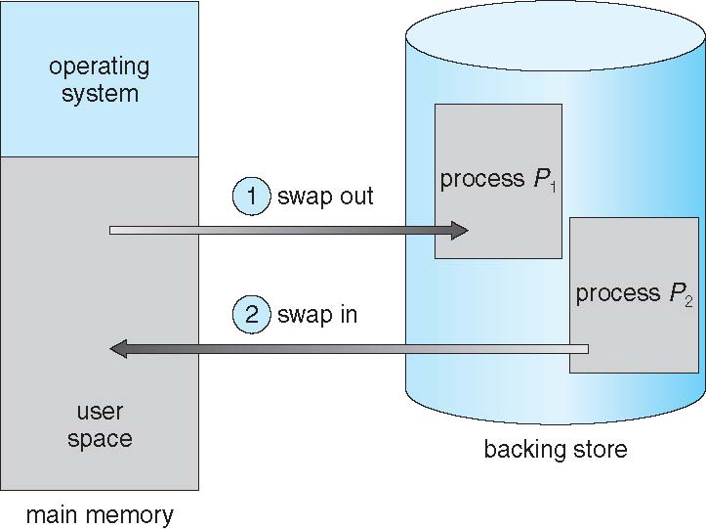
Schematic View of Swapping

Slide 13
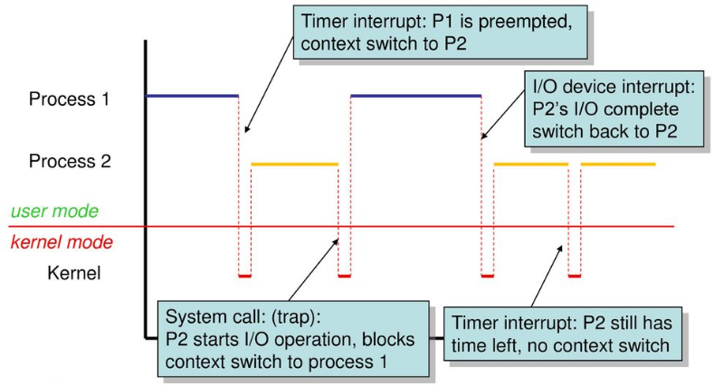
Context Switch Time including Swapping
If next processes to be put on CPU is not in memory, need to swap out a process and swap in target process.
Context switch time can then be very high.
100MB process swapping to hard disk with transfer rate of 50MB/sec.
Swap out time of 2000 ms ➔ 2s.
Plus swap in of same sized process.
Total context switch swapping component time of 4000ms (4 seconds).
Can reduce if reduce size of memory swapped – by knowing how much memory really being used
System calls to inform OS of memory use via;
request memory()and release memory()
Other constraints as well on swapping
Pending I/O – can’t swap out as I/O would occur to wrong process.
Or always transfer I/O to kernel space, then to I/O device.
Known as double buffering, adds overhead
Standard swapping not used in modern operating systems
But modified version common
Swap only when free memory extremely low
A Context switch Scenario

Slide 14
Swapping on Mobile Systems
Not typically supported
Flash memory
is non-volatile computer memory that can be electrically erased and reprogrammed. It's used as primary storage memory on various portable devices due to its low cost, compact size, great physical endurance and low power consumption.
Flash memory based
Small amount of space
Limited number of write cycles
Poor throughput between flash memory and CPU on mobile platform
Instead use other methods to free memory if low
iOS asks apps to voluntarily relinquish allocated memory
Read-only data thrown out and reloaded from flash if needed
Failure to free can result in termination
Android terminates apps if low free memory, but first writes application state to flash for fast restart
Both OSes support paging as discussed below

Slide 15
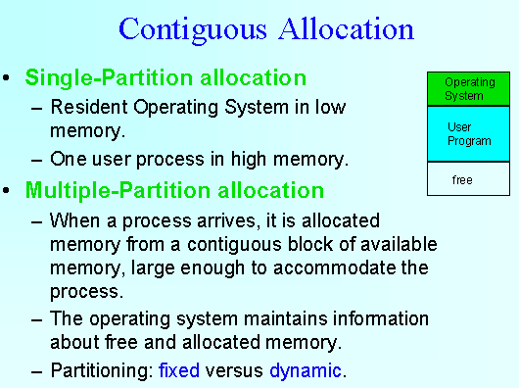
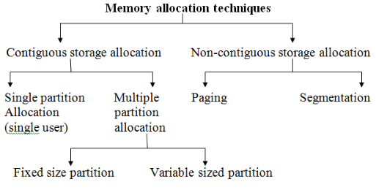
Contiguous Allocation
Main memory must support both OS and user processes.
Limited resource, must allocate efficiently.
Contiguous allocation is one early method.
Main memory usually into two partitions:
Resident operating system, usually held in low memory with interrupt vector
User processes then held in high memory
Each process contained in single contiguous section of memory
Relocation registers used to protect user processes from each other,
and from changing operating-system code and data
Base register contains value of smallest physical address
Limit register contains range of logical addresses –
each logical address must be less than the limit register
MMU maps logical address dynamically
Can then allow actions such as kernel code being transient and kernel changing size
Notes:
Contiguous memory allocation is a memory allocation method that allocates a single contiguous section of memory to a process or a file.
This method takes into account the size of the file or a process and also estimates the maximum size.
The advantage of contiguous memory allocation is it increases the processing speed.
As the operating system uses the buffered I/O and reads the process memory blocks consecutively it reduces the head movements. This speed ups the processing.
The disadvantage of contiguous memory allocation is memory wastage and inflexibility.
As the memory is allocated to a file or a process keeping in mind that it will grow during the run.
But until a process or a file grows many blocks allocated to it remain unutilized.
And they even they cannot be allocated to the other process leading to wastage of memory.

Slide 16
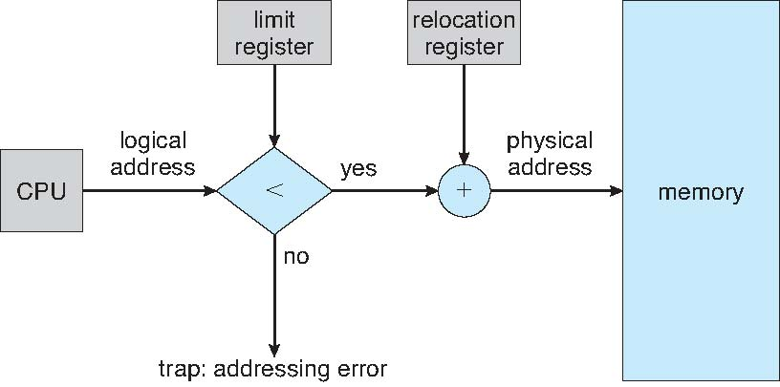
Hardware Support for Relocation and Limit Registers
Logical Address + Relocation Register
➔ Physical Address

Slide 17
Contiguous Allocation (Cont.)
Multiple-partition allocation
Degree of multiprogramming limited by number of partitions
Variable-partition sizes for efficiency (sized to a given process’ needs)
Hole ➔ block of available memory; holes of various size are scattered throughout memory
When a process arrives, it is allocated memory from a hole large enough to accommodate it
Process exiting frees its partition, adjacent free partitions combined
Operating system maintains information about:
a) Allocated Partitions.
b) Free Partitions (hole).
OS
OS
OS
OS
process 5
process 5
process 5
process 5
remove
P8
Hole
Add
P9
process 9
Add
P10
process 9
process 8
Hole
process 10
Hole
process 2
process 2
process 2
process 2
Notes:
In this type of allocation, main memory is divided into a number of fixed-sized partitions where each partition should contain only one process. When a partition is free, a process is selected from the input queue and is loaded into the free partition.

Slide 18
Dynamic Storage-Allocation Problem
How to satisfy a request of size n from a list of free holes?
First-fit: Allocate the first hole that is big enough
Best-fit: Allocate the smallest hole that is big enough; must search entire list, unless ordered by size
Produces the smallest leftover hole
Worst-fit: Allocate the largest hole; must also search entire list
Produces the largest leftover hole
Note: First-fit and best-fit better than worst-fit in terms of speed and storage utilization

Slide 19
Memory fragmentation
Memory fragmentation refers to the phenomenon where free memory in a computer system becomes divided into small, non-contiguous blocks over time, making it challenging to allocate large, contiguous blocks of memory. This fragmentation can occur in both physical and virtual memory systems.
Types of memory fragmentation:
External Fragmentation: This type of fragmentation occurs when free memory blocks are scattered throughout the system, leaving smaller gaps between them that are too small to satisfy the memory allocation requests for larger programs. As a result, even though the total amount of free memory may be sufficient, it may not be available in a single contiguous block, leading to inefficient memory utilization.
Internal Fragmentation: Internal fragmentation happens when allocated memory blocks are larger than necessary, resulting in wasted memory space within each block. This occurs when memory is allocated in fixed-size chunks or pages, and the requested memory size is smaller than the allocated block. The remaining unused space within the block is known as internal fragmentation.

Slide 20
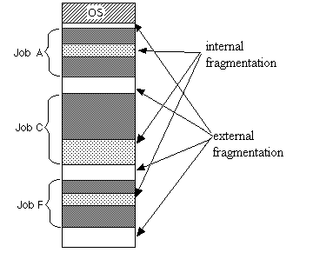
Memory Fragmentation
As processes are loaded and removed from memory, fragmentation occurs in a dynamic memory allocation system when most of the free memory spaces are too small to satisfy any request (Process).
It happens after
sometimes that processes cannot be allocated to memory blocks considering their small size.
sometimes memory blocks remain unused.
External Fragmentation ➔ Total memory space exists to satisfy a request, but it is not contiguous
Internal Fragmentation ➔ Allocated memory may be slightly larger than requested memory; this size difference is memory internal to a partition, but not being used
First fit analysis reveals that given N blocks allocated, 1/2 N blocks lost to fragmentation
1/3 may be unusable ➔ 50-percent rule
Notes:
Processes are stored and removed from memory, which creates free memory space, which are too small to use by other processes.

Slide 21
Memory fragmentation can lead to several issues:
Reduced memory utilization: Fragmentation reduces the overall efficiency of memory usage since free memory blocks may exist but cannot be utilized optimally due to their non-contiguous nature.
Increased allocation failures: As external fragmentation increases, it becomes more challenging to find a contiguous block of memory to fulfill allocation requests, leading to more frequent allocation failures.
Reduced Performance: Fragmentation can result in increased overhead and slower memory access times due to the need for frequent memory compaction or traversal of non-contiguous memory blocks.

Slide 22
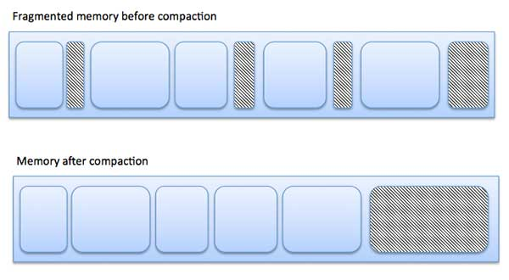
Fragmentation (Cont.)
Reduce external fragmentation by compaction
Shuffle memory contents to place all free memory together in one large block.
Compaction is possible only if relocation is dynamic, and is done at execution time.
I/O problem
Latch job in memory while it is involved in I/O.
Do I/O only into OS buffers.
Now consider that backing store has same fragmentation problems
Static relocation refers to address transformations being done before execution of a program begins.
Dynamic relocation refers to address transformations being done during execution of a program.
Free memory
Notes:
relocation is dynamic mean it is happen in execution time.

Slide 23
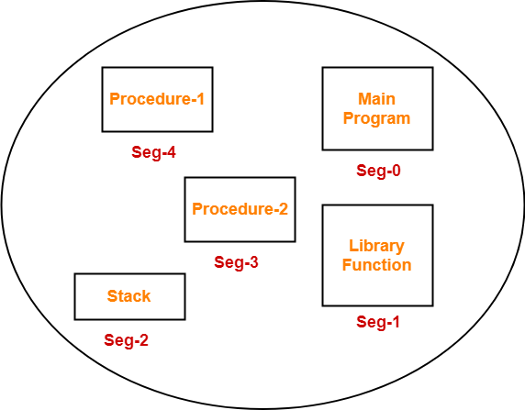
Segmentation
Memory-management scheme that supports user view of memory
A program is a collection of segments
A segment is a logical unit such as:
main program
procedure
function
method
object
local variables, global variables
common block
stack
symbol table
arrays
User’s View of a Program
Notes:
As we’ve already seen, the user’s view of memory is not the same as the actual physical memory. This is equally true of the programmer’s view of memory.
Segmentation is a memory-management scheme that supports this programmer view of memory. A logical address space is a collection of segments.

Slide 24
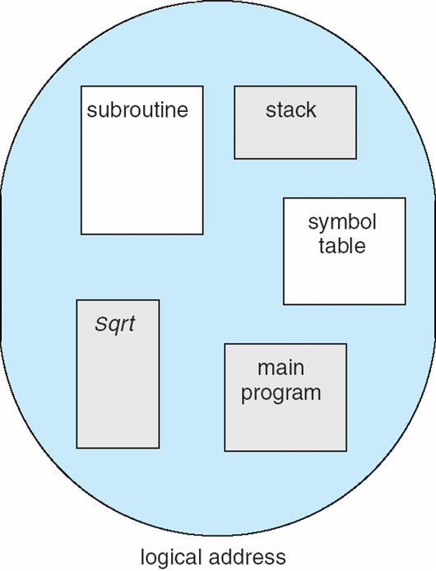
User’s View of a Program
Notes:
Segmentation is a memory-management scheme that supports this programmer view of memory. A logical address space is a collection of segments.

Slide 25
Logical View of Segmentation
1
1
4
2
3
4
2
3
user space
physical memory space

Slide 26
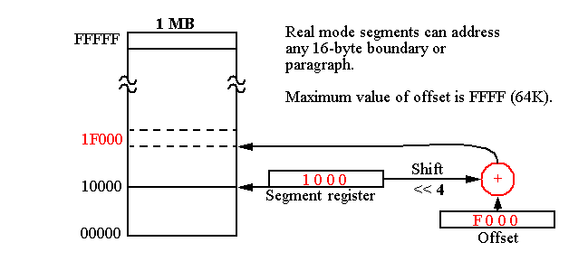
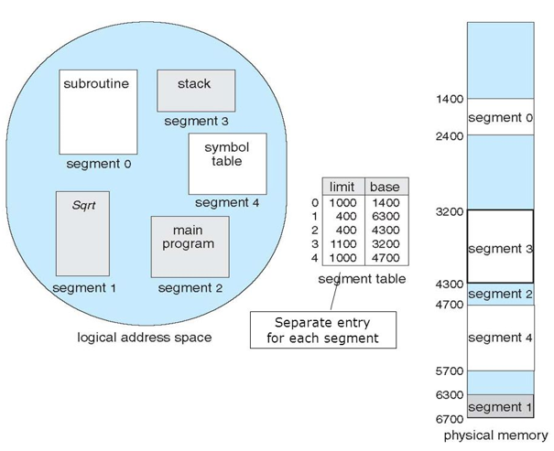
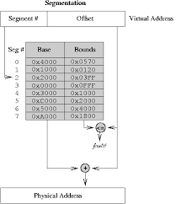
Segmentation Architecture
Logical address consists of a two tuple:
<segment-number, offset>,
Segment table ➔ maps two-dimensional physical addresses; each table entry has:
base ➔ contains the starting physical address where the segments reside in memory
limit ➔ specifies the length of the segment
Segment-table base register (STBR)
points to the segment table’s location in memory
Segment-table length register (STLR)
indicates number of segments used by a program;
segment number s is legal
if s < STLR
Notes:
Each segment has a name and a length. The addresses specify both the segment name and the offset within the segment. The programmer therefore specifies each address by two quantities: a segment name and an offset.
When a program is compiled, the compiler automatically constructs segments reflecting the input program.
The segment base contains the starting physical address where the segment resides in memory, and the segment limit specifies the length of the segment.

Slide 27
Segmentation Architecture (Cont.)
Protection
With each entry in segment table associate:
validation bit = 0 ⇒ illegal segment
read/write/execute privileges
Protection bits associated with segments; code sharing occurs at segment level.
Since segments vary in length, memory allocation is a dynamic storage-allocation problem
A segmentation example is shown in the following diagram

Slide 28
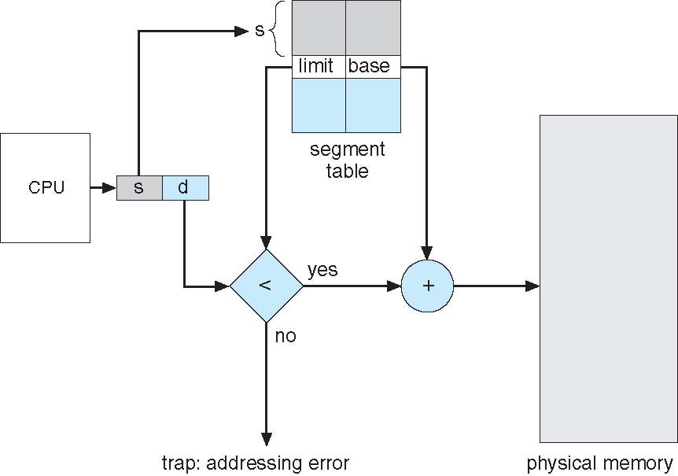
Segmentation Hardware
Notes:
A logical address consists of two parts: a segment number, s, and an offset into that segment, d.
The segment number is used as an index to the segment table. The offset d of the logical address must be between 0 and the segment limit.
If it is not, we trap to the operating system (logical addressing attempt beyond end of segment).
When an offset is legal, it is added to the segment base to produce the address in physical memory of the desired byte.
The segment table is thus essentially an array of base–limit register pairs.

Slide 29
Paging
The paging method in computer memory management is a technique used to organize and allocate memory in a system. It divides the physical memory into fixed-size blocks called pages and the logical memory into equal-sized blocks called frames. The main idea behind paging is to allow processes to be divided into smaller, fixed-size units of memory, making it easier to manage and allocate memory resources. Each page represents a unit of data or code within a process, while each frame represents a corresponding block of physical memory. The paging method uses a page table to keep track of the mapping between logical pages and physical frames. When a process needs to access a particular page, the page table is consulted to determine the corresponding physical frame location.

Slide 30
Advantages:
1. Simplified memory management: Paging simplifies memory management by dividing memory into fixed-size pages, allowing for efficient allocation and deallocation of memory resources.
2. Memory protection: Paging provides memory protection by assigning access permissions to individual pages, allowing the operating system to control the access rights of processes to different areas of memory.
Disadvantages:
1. Overhead: Paging introduces additional overhead due to the need for maintaining and updating the page table. This overhead includes the storage space required for the page table itself and the additional memory access time to perform address translations.
2. Fragmentation: Paging can lead to internal fragmentation, where there may be unused space within a page. This occurs when a process does not fully utilize the entire page, resulting in wasted memory resources.

Slide 31
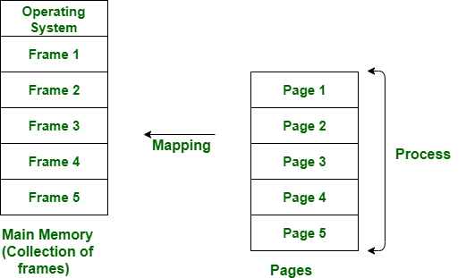
Paging
Physical address space of a process can be noncontiguous; process is allocated physical memory whenever the latter is available
Avoids external fragmentation.
Avoids problem of varying sized memory chunks.
Divide physical memory into fixed-sized blocks called frames.
Size is power of 2, between 512 bytes and 16 Mbytes
Divide logical memory into blocks of same size called pages.
Keep track of all free frames
To run a program of size N pages, need to find N free frames and load program.
Set up a page table to translate logical to physical addresses.
Backing store likewise split into pages.
Still have Internal fragmentation.
Notes:
Segmentation permits the physical address space of a process to be non-contiguous. Paging is another memory-management scheme that offers this advantage.
It also solves the considerable problem of fitting memory chunks of varying sizes onto the backing store.
Paging is implemented through cooperation between the operating system and the computer hardware.
The problem arises because, when code fragments or data residing in main memory need to be swapped out, space must be found on the backing store.
The backing store has the same fragmentation problems discussed in connection with the main memory, but access is much slower,
so compaction is impossible. Because of its advantages over earlier methods,
paging in its various forms is used in most operating systems, from those for mainframes through those for smartphones.

Slide 32
Address Translation Scheme
Address generated by CPU is divided into:
Page number (p) ➔ used as an index into a page table which contains base address of each page in physical memory
Page offset (d) ➔ combined with base address to define the physical memory address that is sent to the memory unit
For given logical address space 2^{m} and page size 2^{n}
page number
page offset
p
d
m - n
n

Slide 33
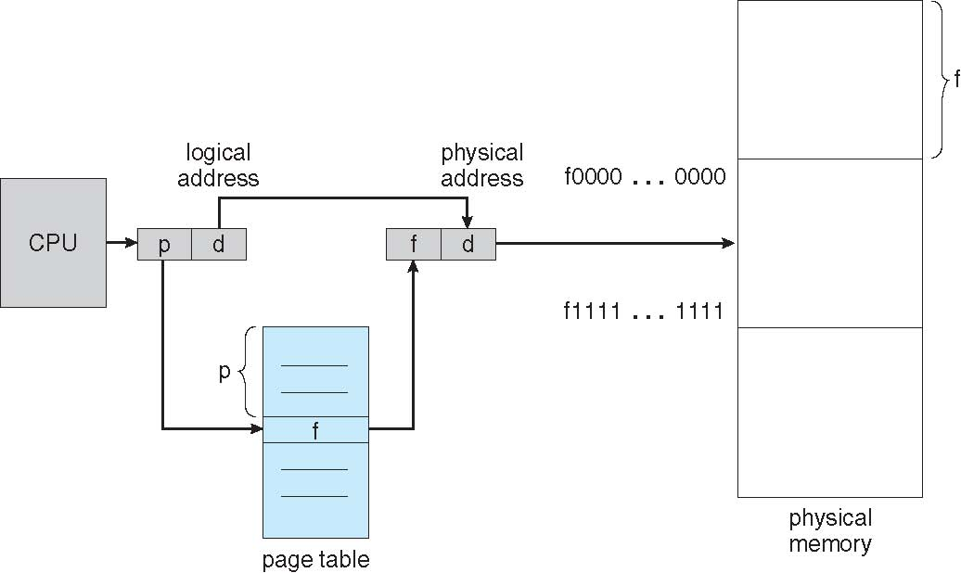
Paging Hardware

Slide 34
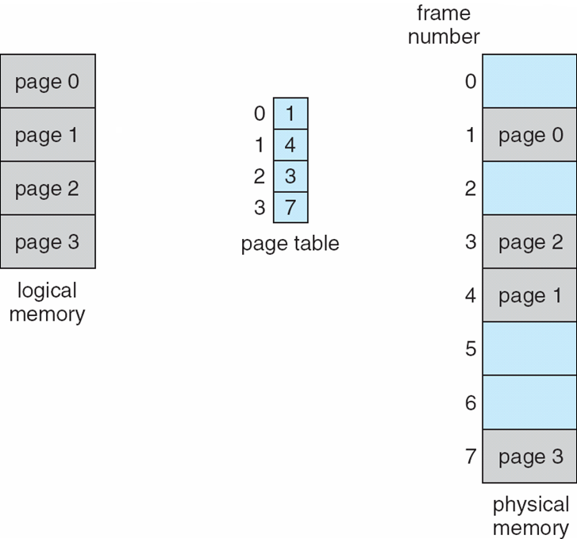
Paging Model of Logical and Physical Memory

Slide 35
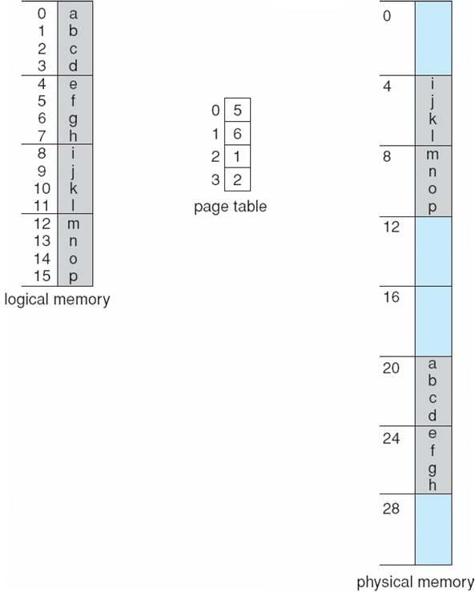
Paging Example
n=2 and m=4
32-byte memory and 4-byte pages

Slide 36
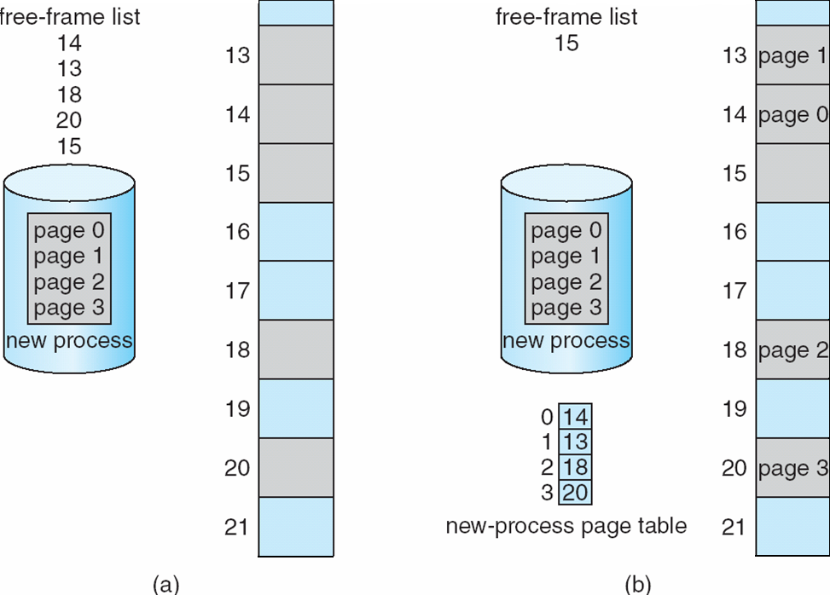
Free Frames
free
Before allocation
After allocation

